Slide 1
A project on whole-genome assembly, annotation and phylogenetic analysis
Margaret Wanjiku
Group 5
9th July 2019

Slide 2
Background
Rice blast is a fungal disease of rice whose symptoms are lesions on various parts of the plant, inducing severe loss of productivity for farmers
The agent causing the disease is the fungus Magnaporthe oryzae, that has been quite extensively studied in Asia and Africa
The major difficulty in controlling rice blast with genetic resistance is that there are many races of the pathogen
Our mini project aims at understanding the genetic relationship between several fungal isolates

Slide 3
Objectives
To asses the success of 2nd-generation sequencers (Illumina HiSeq) in sequencing Magnaporthe oryzae
To study the genetic diversity of Magnaporthe oryzae in our samples
To compare our rice blast sequences with other rice blast accessions from Africa and Asia

Slide 4
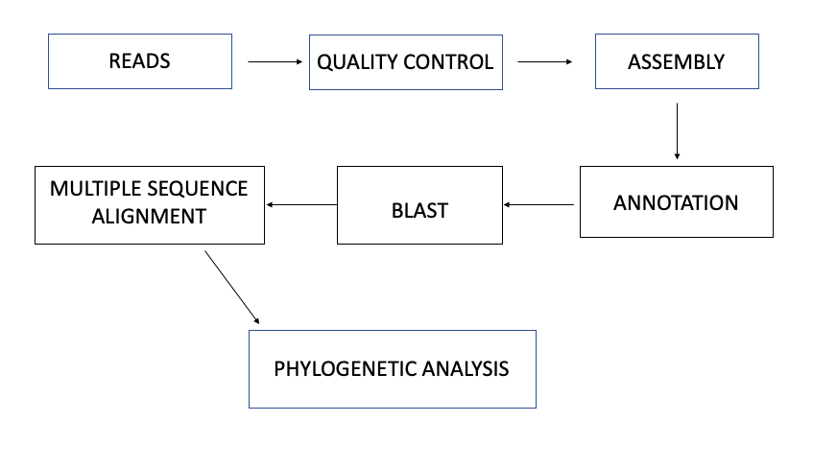
Materials and Methods

Slide 5
Reads
Quality check:
-FastQC
-Samtools
-Kraken
Assembly:
-velvet
-trinity

Slide 6
Annotation:
Artemis
Geneious
Blast a public database
Alignment:
Mafft

Slide 7
Phylogeny:
Gene-specific trees
PhyML
Phylogeny alongside other accessions from Africa and Asia

Slide 8
Thank you

